Slide 1
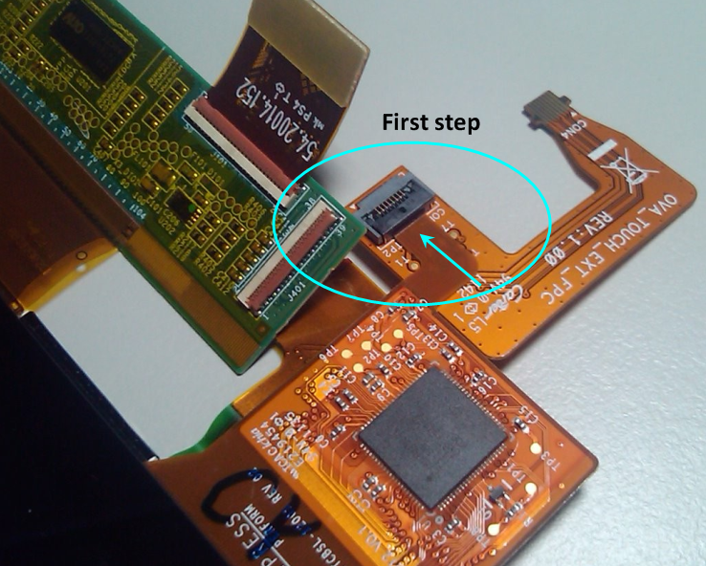
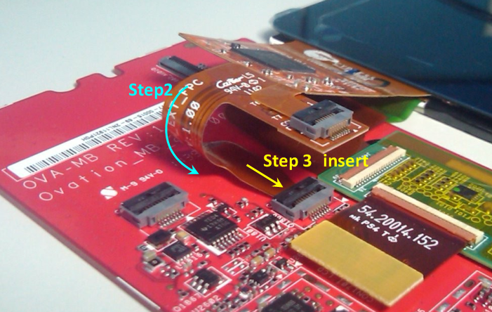
Main connected to touch and 9” LCD
LCD BtoB conn

Slide 2
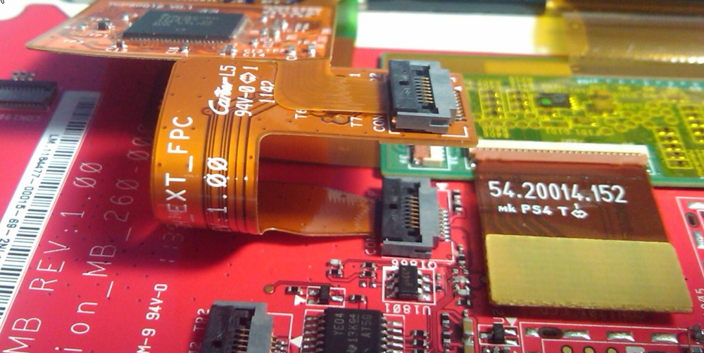
Should be like below picture

Slide 3
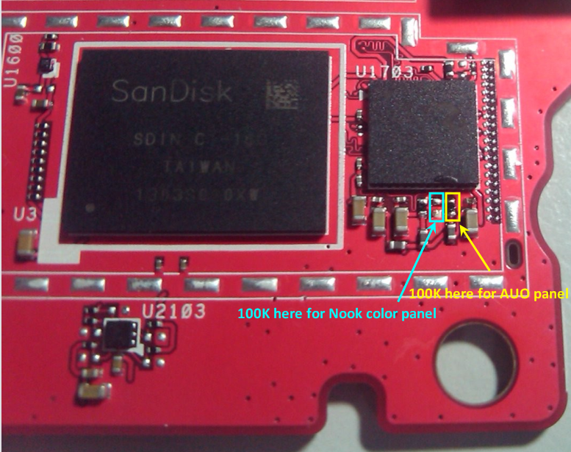
As below picture, currently, 100K there for AUO panel.

Slide 4
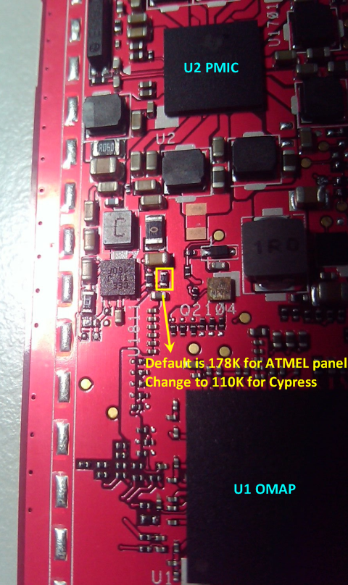
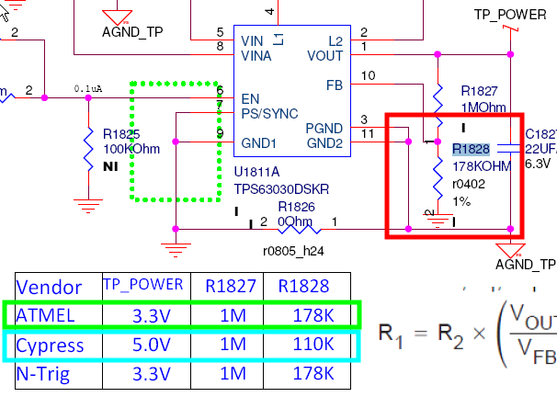
As the right side picture.
The marked one is R1828,
you can refer to the below table.

